Slide 1
DHCP & ARP
Course Code: CSC 3116
Course Title: Computer Networks
Dept. of Computer Science
Faculty of Science and Technology
Lecturer No: | 8 | Week No: | 8 | Semester: | Summer 19_20
Lecturer: | Wardah Saleh, wardah@aiub.edu

Slide 2
Lecture Outline
DHCP
What is DHCP?
How DHCP works?
Steps of DHCP
ARP
What is ARP?
How ARP works?
ARP cache timeout
Advantage
Disadvantage

Slide 3
What is DHCP
Dynamic Host Configuration Protocol (DHCP) is a network protocol that enables a server to automatically assign an IP address to a computer from a defined range of numbers configured for a given network.

Slide 4
Basic Term BOOTP
The Bootstrap Protocol (BOOTP) is a computer networking protocol used in Internet Protocol(IP) networks to automatically assign an IP address to network devices from a configuration server.
When a computer that is connected to a network is powered up and boots its operating system, the system software broadcasts BOOTP messages onto the network to request an IP address assignment. A BOOTP configuration server assigns an IP address based on the request from a pool of addresses configured by an administrator.

Slide 5
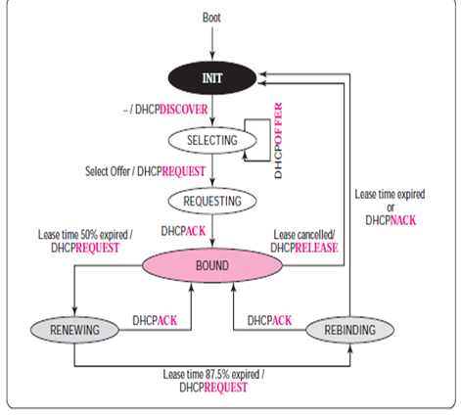
How DHCP works

Slide 6
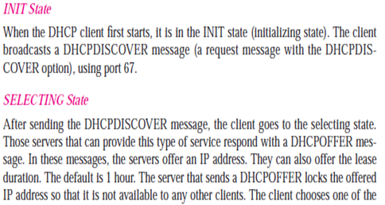

Steps of DHCP

Slide 7
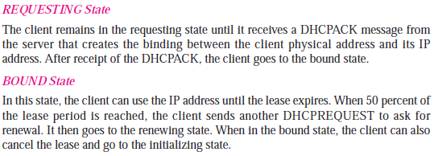
Steps of DHCP (cont…)

Slide 8
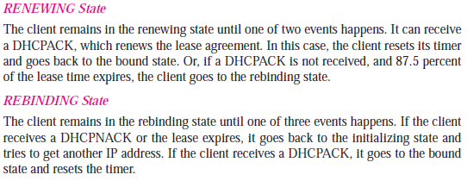
Steps of DHCP (cont…)

Slide 9
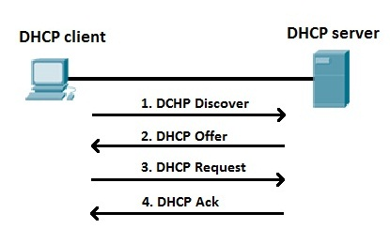
DHCP process explained:

Slide 10
What is ARP?
In networking it is necessary for the sender to know the IP address and the Physical address of the receiver for successful communication. If the MAC address of the receiver is unknown to the sender; it uses ARP protocol to identify the specific MAC address of the receiver.

Slide 11
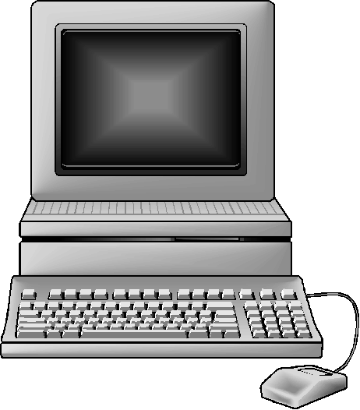
ARP Request
PC – A PC – B PC- C
IP Add. : 10.0.0.5 IP Add. : 10.0.0.3 IP Add. : 10.0.0.1
MAC Add. MAC Add. MAC Add.
:AA:AA:AA:AA:AA :BB:BB:BB:BB:BB:BB :CC:CC:CC:CC:CC:CC
In the above scenario there are three computers in a single network. PC-A wants to communicate with PC-C. But it only knows the IP address of PC-C. So, PC-A will
take the help of ARP to get the MAC address of PC-C.

Slide 12
ARP Request (cont…)
Packet (Network layer):
10.0.0.5 | 10.0.0.1 | I want to know the MAC address of that interface who’s ip address is 10.0.0.1
Frame (Data Link layer):
:AA:AA:AA:AA :AA | FFFF:FFFF:FFFF

Slide 13
ARP Request (cont…)
After making the ARP request frame PC-A will broadcast the frame in the network. Assume that PC-B have got the frame it will read the header of the frame and find out the physical address (FFFF:FFFF:FFFF) as destination MAC address. Which means it’s a broadcast MAC address and the frame is for everyone in that network. Therefore, PC-B will take the frame to the network layer. In the network layer when the destination IP address is checked. There will be a mismatch as PC-B doesn’t hold the ip address 10.0.0.1.

Slide 14
ARP Reply
Packet (Network layer):
10.0.0.1 | 10.0.0.5 | My MAC address is :CC:CC:CC:CC:CC:CC
Frame (Data Link layer):
:CC:CC:CC:CC:CC:CC | :AA:AA:AA:AA :AA

Slide 15
ARP Reply (cont…)
On the other hand, when PC-C will get the frame it will read the header of the frame and find out the physical address (FFFF:FFFF:FFFF) as destination address. So, PC-C will transfer it to network layer. In network layer the host will check the destination IP and finds out that it matches with its own IP address. Therefore, PC-C will start reading the content of the packet. And it will make an ARP reply frame and send it back to PC- A.

Slide 16
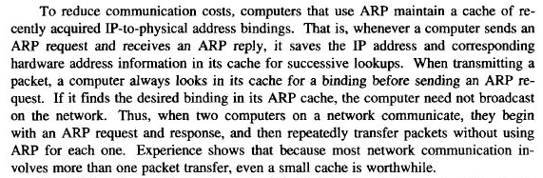
ARP Cache Timeout

Slide 17
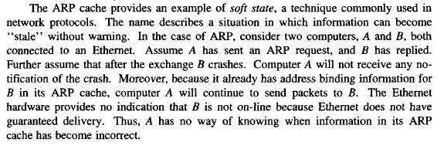
ARP Cache Timeout (cont…)

Slide 18
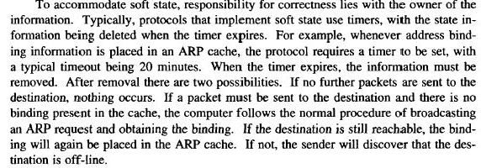
ARP Cache Timeout (cont…)

Slide 19
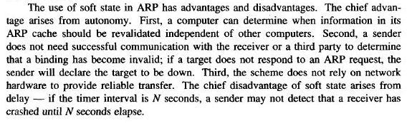
Advantage/Disadvantage

Slide 20
References
Data Communications and Networking, B. A. Forouzan, McGraw-Hill, Inc., Fourth Edition, 2007, USA.
https://www.geeksforgeeks.org/basics-computer-networking/
https://www.tutorialspoint.com/computer_fundamentals/computer_networking.htm

Slide 21
Books
Data Communications and Networking, B. A. Forouzan, McGraw-Hill, Inc., Fourth Edition, 2007, USA.
Computer Networking: A Top-Down Approach, J. F., Kurose, K. W. Ross, Pearson Education, Inc., Sixth Edition, USA.
Official Cert Guide CCNA 200-301 , vol. 1, W. Odom, Cisco Press, First Edition, 2019, USA.
CCNA Routing and Switching, T. Lammle, John Wily & Sons, Second Edition, 2016, USA.
TCP/IP Protocol Suite, B. A. Forouzan, McGraw-Hill, Inc., Fourth Edition, 2009, USA.
Data and Computer Communication, W. Stallings, Pearson Education, Inc., 10th Education, 2013, USA.

